Slide 1
Property Assessment of Derelict Buildings in Ireland Using LiDAR and Photogrammetry
Dylan O'Donnell | South East Technological University April 2025

Slide 2
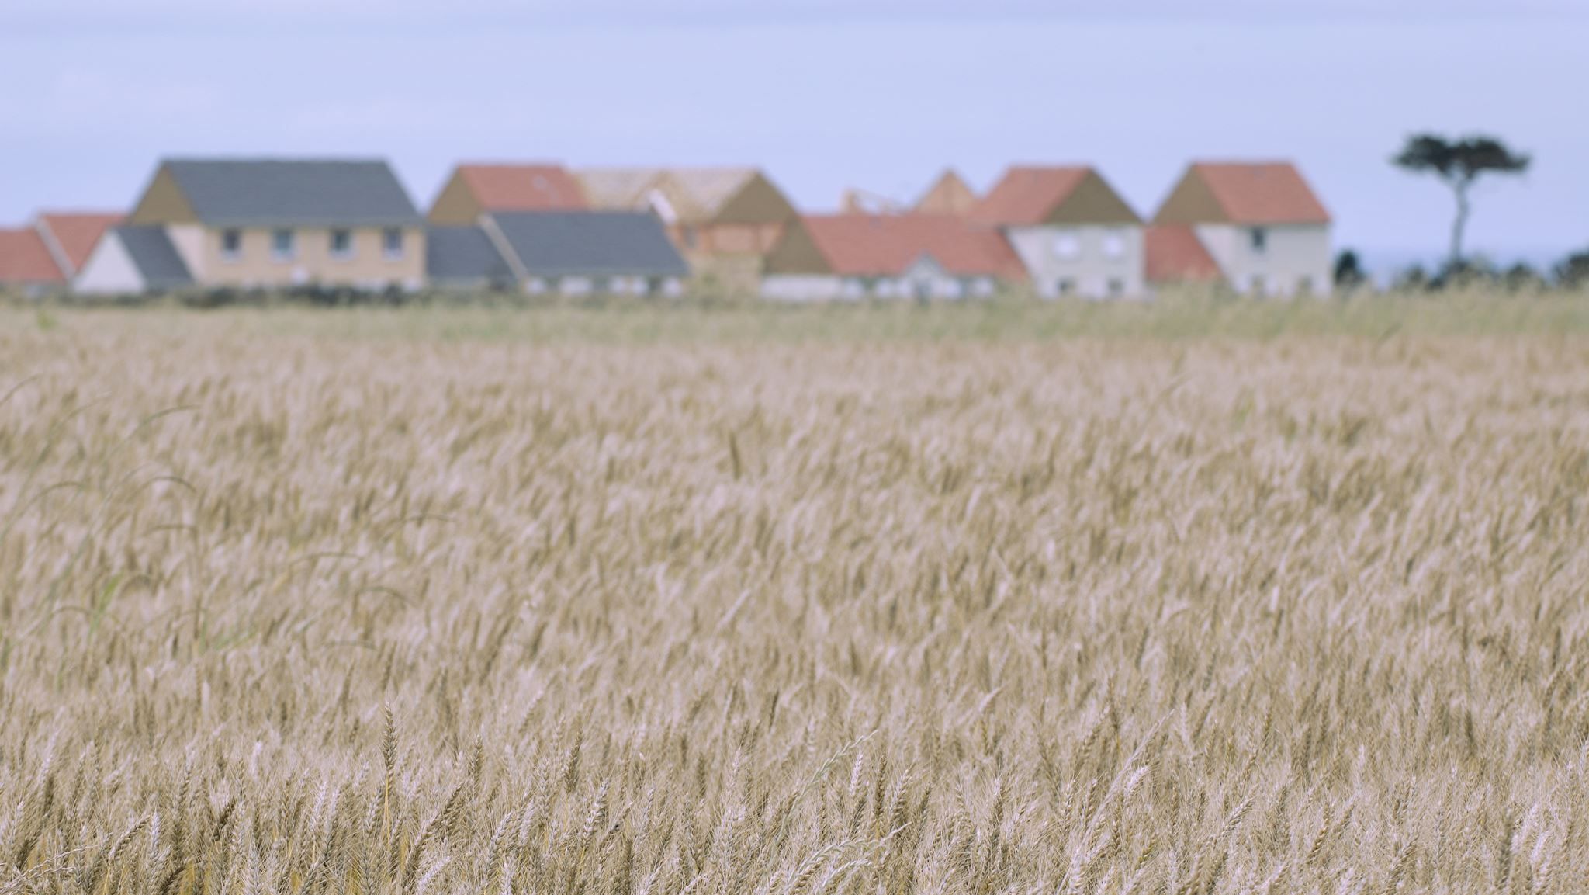
The Problem:
Ireland's Housing Crisis
81,000 vacant and derelict properties across Ireland
Traditional assessment methods are barriers to redevelopment:
€5,700-€11,000 per property cost
4-6 hours of on-site time
High costs prevent local authorities, community housing organizations, and individual owners from pursuing renovation

Slide 3
The proposed Solution
Consumer-grade LiDAR and photogrammetry technology
iPhone 16 Pro LiDAR scanner
Generate accurate 3D models for assessment
Significantly reduces cost and time requirements
Enables remote evaluation and sharing

Slide 4
Technical Implementation
Hardware & Software
iPhone 16 Pro with built-in LiDAR sensor
Polycam and Scaniverse scanning apps
Sketchfab for model hosting and sharing
Scanning Process
Room-by-room approach with 25% overlap
Detail capture for complex features and damage
Validation against professional measuring tools

Slide 5
Demonstration Results
Accuracy & Performance
99.25% measurement accuracy compared to traditional methods
±8.2cm mean deviation across all measurements
85% reduction in on-site time (1 hour vs 4-6 hours)

Slide 6
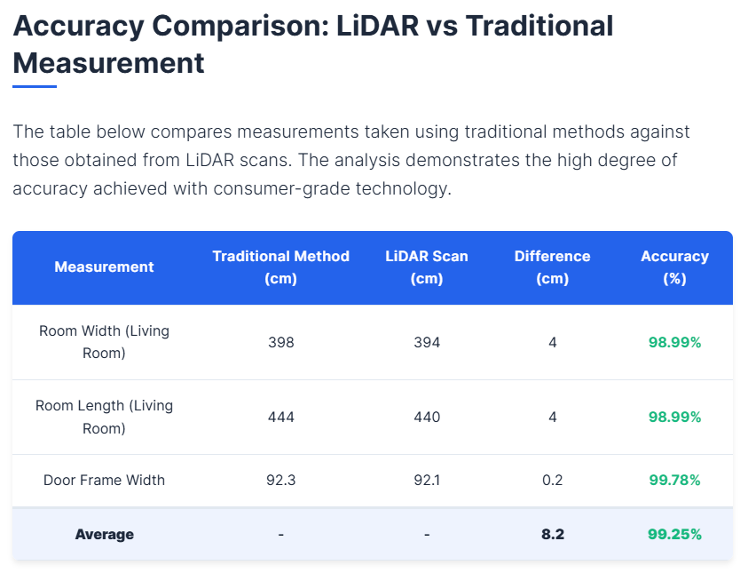

Slide 7
Cost-Benefit Analysis
Traditional vs. LiDAR Assessment
78-87% cost reduction
Assessment Method | Cost per Property | Time On-Site | Scale Cost (100 properties)
Traditional | €5,700-€11,000 | 4-6 hours | €570,000-€1,100,000
LiDAR-based | €700-€1,450 | ~1 hour | €70,000-€145,000

Slide 8
Business Implementation Models
Government Partnership Model
Public-private partnerships with local authorities
Centralized property database
Commercial Service Model
Tiered pricing for developers and investors
Subscription services for ongoing property data
Community Initiative Model
Equipment lending for community organizations
Training and open-source tools

Slide 9
Ethical Considerations
Privacy Protection: GDPR-compliant data handling, consent procedures
Professional Integration: Complementary roles rather than displacement
Community Impact: Housing affordability, preventing gentrification
Accessibility: Reducing barriers to property assessment technology

Slide 10
Technical Evaluation Results
Business Requirement | Traditional | LiDAR | Key Advantage
Cost Efficiency | 1/4 | 4/4 | 78-87% cost reduction
Time Efficiency | 1/4 | 4/4 | 85% time savings
Accuracy | 4/4 | 3/4 | 99.25% accuracy (sufficient for planning)
Accessibility | 1/4 | 3/4 | Usable by non-specialists
Data Quality | 2/4 | 4/4 | Comprehensive 3D documentation
Scalability | 1/4 | 3/4 | Feasible for large-scale implementation

Slide 11
Key Findings & Recommendations
Hybrid Implementation: Use LiDAR for initial assessments, traditional methods for specialized evaluation
Phased Deployment:
Pilot (6 months): 5-10 properties with selected councils
Limited deployment (12 months): 50-100 properties
Scale-up (24 months): 1,000+ properties annually
Training Programs for professionals and community organizations
Technical Infrastructure for secure 3D model repositories

Slide 12

Conclusion: The Opportunity
Consumer technology has matured enough to address a significant challenge
Potential to transform 81,000 derelict Irish properties
Greatest impact in counties with highest dereliction:
Mayo (14.0%)
Donegal (11.6%)
Galway (8.8%)
LiDAR assessment could play a vital role in addressing Ireland's housing crisis

Slide 13

Thank You
Questions?
Project website: https://showcase.itcarlow.ie/it.html
Demo video: https://youtu.be/PZ28iOW5xcA
Dylan O'Donnell | South East Technological University

